Slide 1
INSURANCE Analytics PROJECT (P574)
- Shweta Sandesh Shelke

Slide 2
summary
The Insurance Analytics Project was initiated with the purpose to evaluate the branch sales. The primary objectives were to focus on different targets, employee performance and to identify areas of opportunity. To achieve these goals we employed different strategies, created relationships between the datasets, used calculated fields and measures.
Throughout the project, we made use of KPIs and essential visualizations to make the dashboard easily readable. The key findings include the individual targets, their achievements, and the various opportunities that exists. These results are significant because, it helps in finding the underlying growth areas and to develop strategies to improve the performance of individuals.
In conclusion, this sales oriented Insurance Analytics dashboard provides us the branch sales for a certain period and also the areas in which the business needs to focus more on.

Slide 3
Kpi list
1. No of Invoice by Account Executive
2. Yearly Meeting Count
3. a. Cross Sell- Target, Achieved, Invoice
b. New- Target, Achieved, Invoice
c. Renewal- Target, Achieved, Invoice
4. Stage Funnel by Revenue
5. No of meeting by Account Executive
Top Open Opportunity
Opportunity Product Distribution
Top Opportunity by Revenue

Slide 4
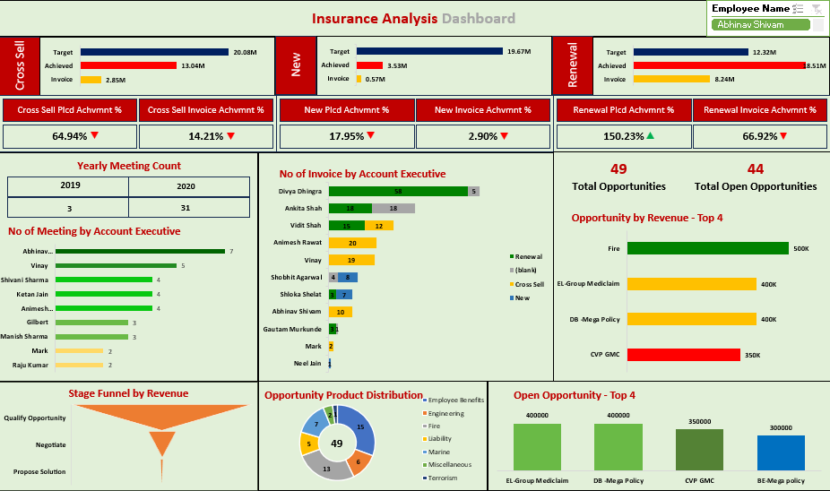
Excel dashboard

Slide 5
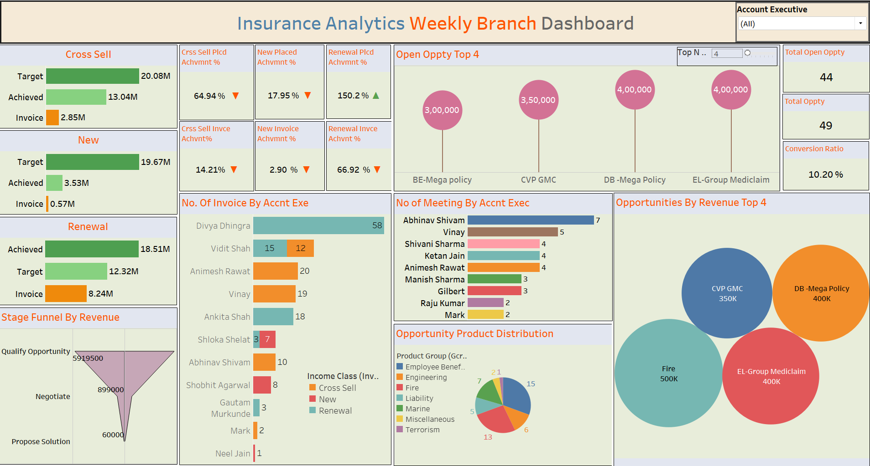
Tableau dashboard

Slide 6
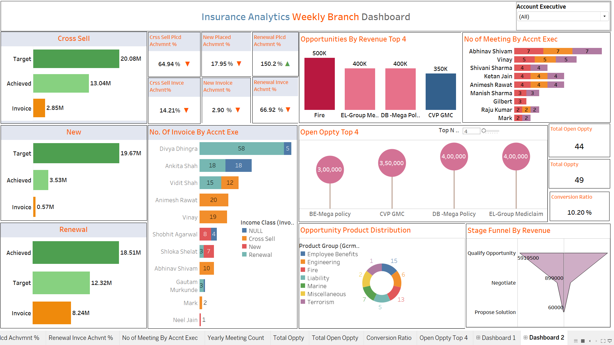
Power bi dashboard

Slide 7
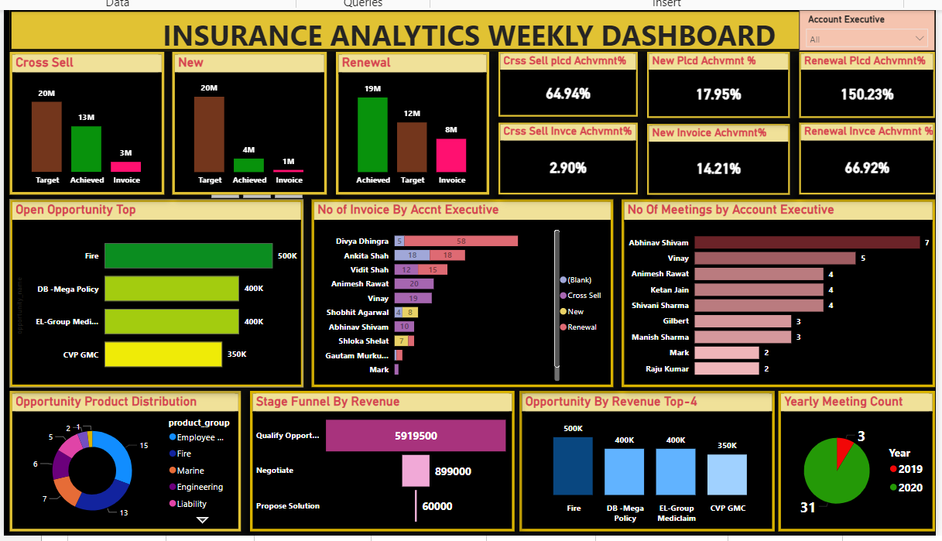
Power bi dashboard

Slide 8
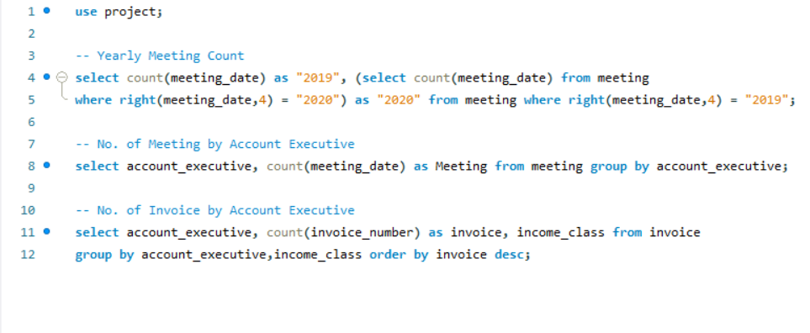
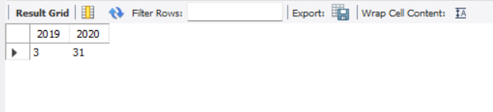
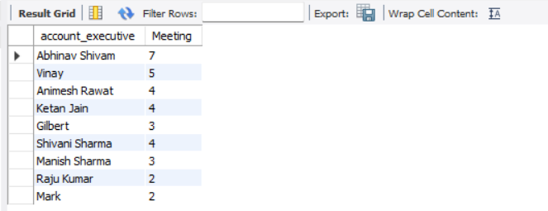
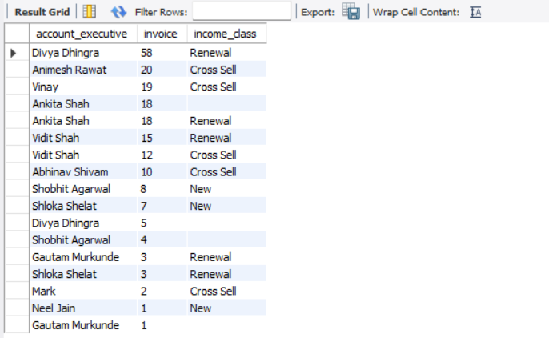
SQL queries

Slide 9
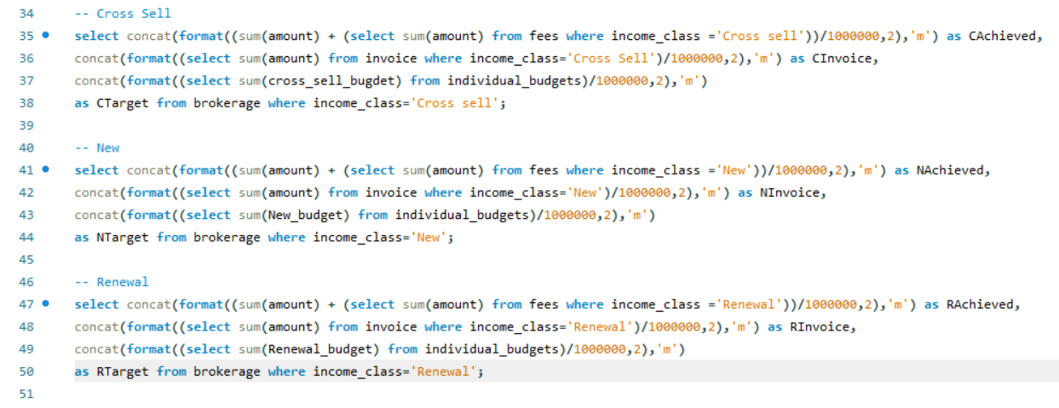

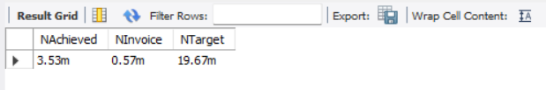
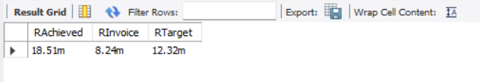

Slide 10
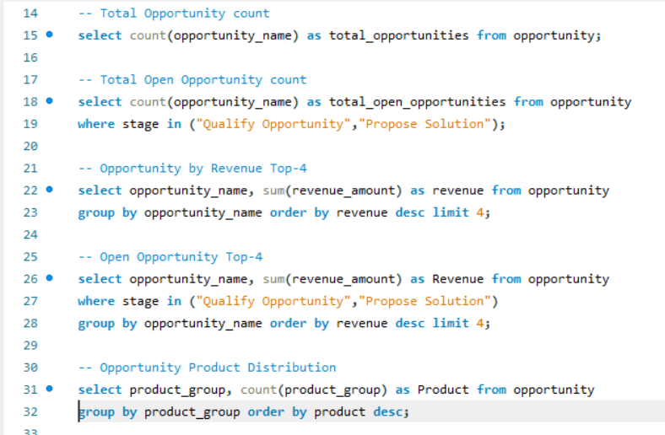


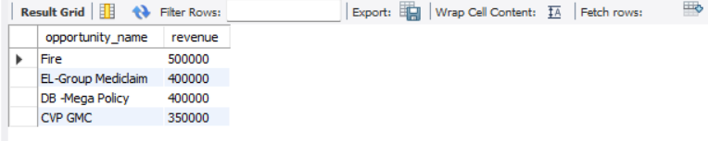
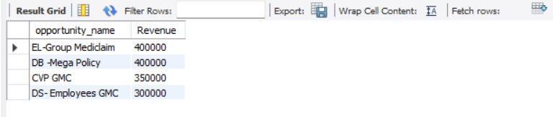
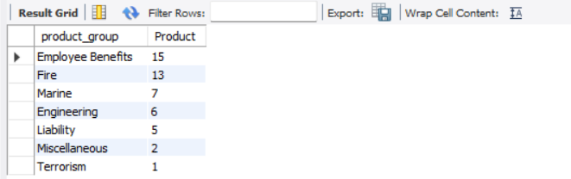

Slide 11
Key Takeaways
The company performed well in renewal achieved business. However, invoice, new and cross-sell achievements need improvement.
Encouraging consistent meeting participation by account executives can enhance results.
In any business, for a company to grow the customers are really important. Besides, maintaining relations with the old ones, one has to look out for the new customers, it’ll help the business grow.
Divya Dhingra excelled in generating invoices, it should be a norm to every other executive in the company. Diversifying across segments can boost company profits.
There is room for improvement in the business. Leveraging existing clients for referrals can be beneficial.
Employee Benefits and Fire are the top-selling products. Efforts need to be made to improve sales of lesser-known products.
There is a distinct gap between qualify opportunity and propose solution. Ensuring business remains in the pipeline can lead to profitability.

Slide 12
Thank you

